Slide 1
Writing a Port Scanner with Python
KEA IT-TECH Alumni Thor Kristiansen

Slide 2

TOC
Why Python?
A Simple Listening Server C# vs PY
Interesting Modules
Exceptions
Code is Poetry
Examples of Banner Grabbing
Demonstration
Questions?
EOF

Slide 3
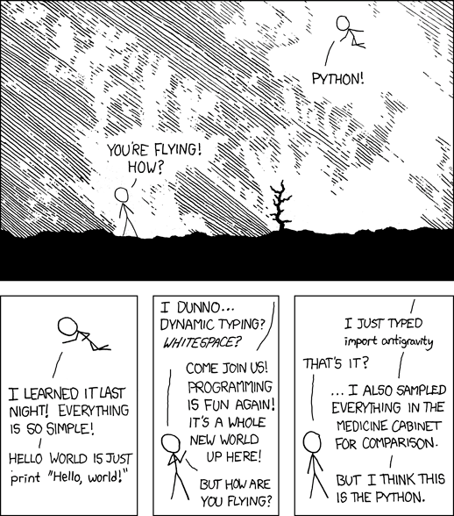
Why Python?
Python is fast, despite being an interpreted language
Python is broad e.g. Django for web dev
Python is easy AND powerful at the same time

Slide 4
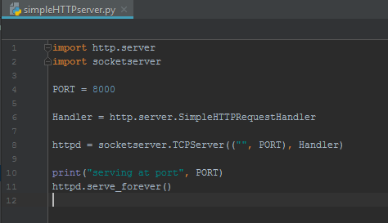
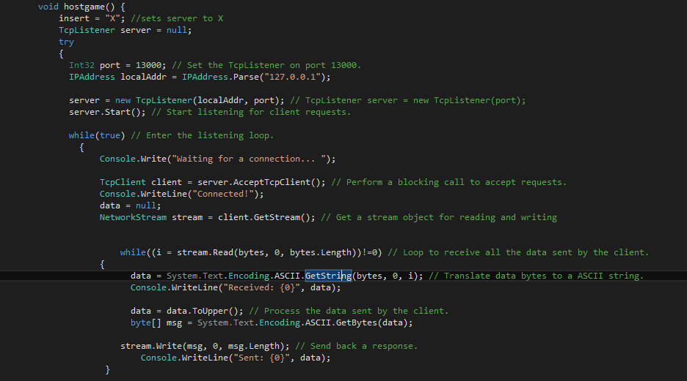
A Simple Listening Server C# vs PY

Slide 5
Interesting Modules
Argparse:
” The argparse module makes it easy to write user-friendly command-line interfaces.”
New in Python 3.2
Socket:
A module to provide access to the socket interface.
Threading:
” Module constructs higher-level threading interfaces on top of the lower level _thread module.”
Nmap:
” A python class to use nmap and access scan results from python3.”

Slide 6

Important Socket Module Constants
socket.AF_INET:
For IP version 4
socket.AF_INET6:
For IP version 6
socket.SOCK_STREAM:
For TCP
socket.SOCK_DGRAM:
For UDP
socket.SOCK_RAW:
Raw, meaning no protocol. Used for package sniffing

Slide 7
Exceptions
Importerror:
”Raised when the import statement has troubles trying to load a module.”
Runtimeerror:
” Raised when an error is detected that doesn’t fall in any of the other categories.”
Connectionerror:
” A base class for connection-related issues.”
Socket.timeout:
Special exception only works when Socket module is imported.
Relies on socket.settimeout()
Windowserror:
To handle errors that are raised by windows and passes back the error num and information.

Slide 8
Code is Poetry
Hope You love it!

Slide 9
Demonstration

Slide 10
Questions?

Slide 11
EOF
Thank You for listening!

